Slide 1

Time-Lapse Video Synthesis from a Single Outdoor Image
Dao Quang Tung, Nguyen Duc Khoa
Samsung STP

Slide 2
Problem & Motivation
The Challenge
Time-lapse videos are visually appealing but difficult and costly to create
Require sophisticated hardware setup and time-consuming capture process
Goal: Synthesize time-lapse videos from a single outdoor image using deep neural networks

Slide 3
Related work
Image & Video Stylization
Previous work: Focused on transferring an image from a source domain to a target domain (e.g., day to night, sketch to photo) while preserving the content.
Our approach: Instead of a discrete domain transfer, our method creates a continuous change in illumination.

Slide 4
Related work
Animation Still Images
Previous work: The most related method is a data-driven approach that creates time-lapses by finding a reference video in a large database to guide the color transfer.
Limitation: This requires storing an entire video database at runtime and may fail if no semantically similar reference video can be found.
Our approach: Only requires storing a compact model and needs no reference video at runtime, making our approach more robust and efficient

Slide 5
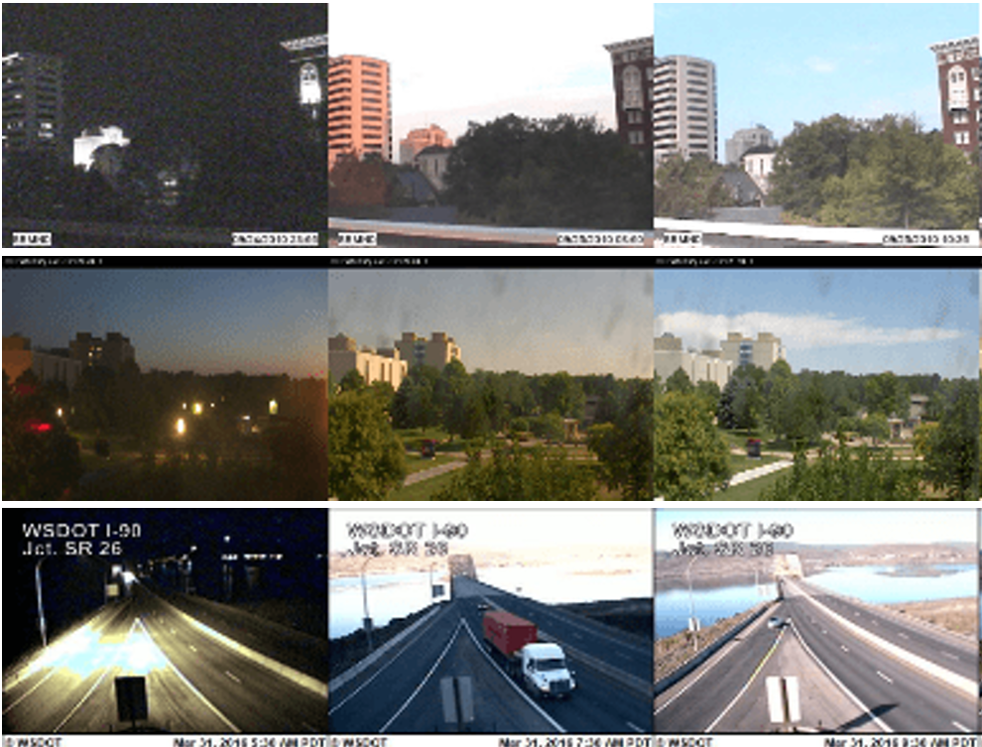
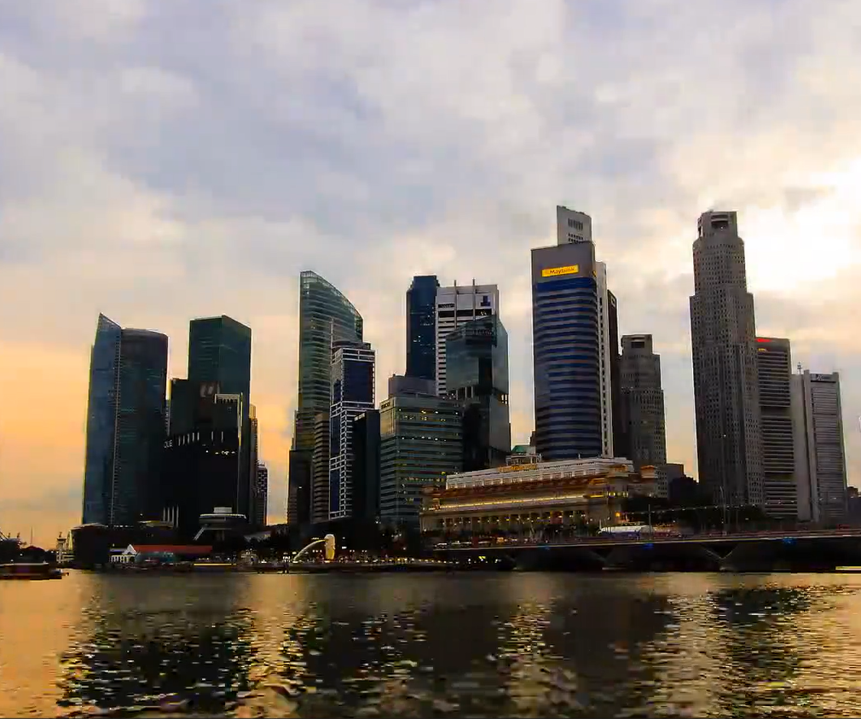
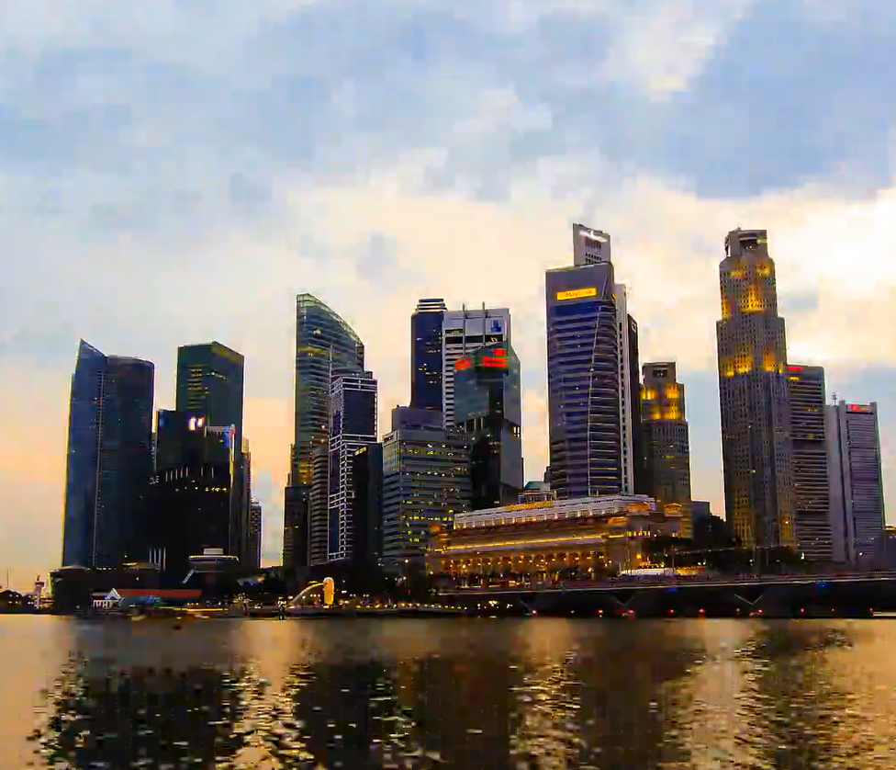
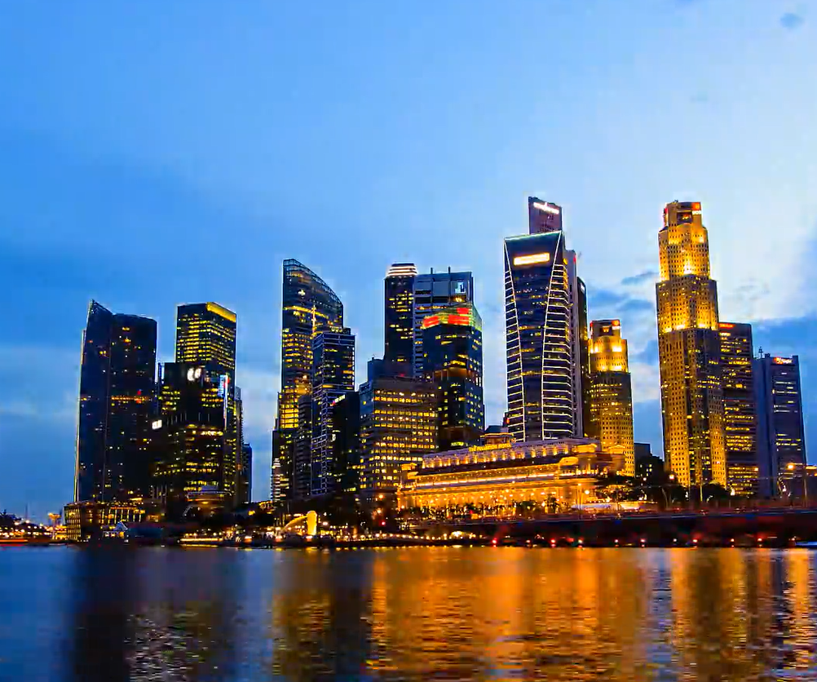
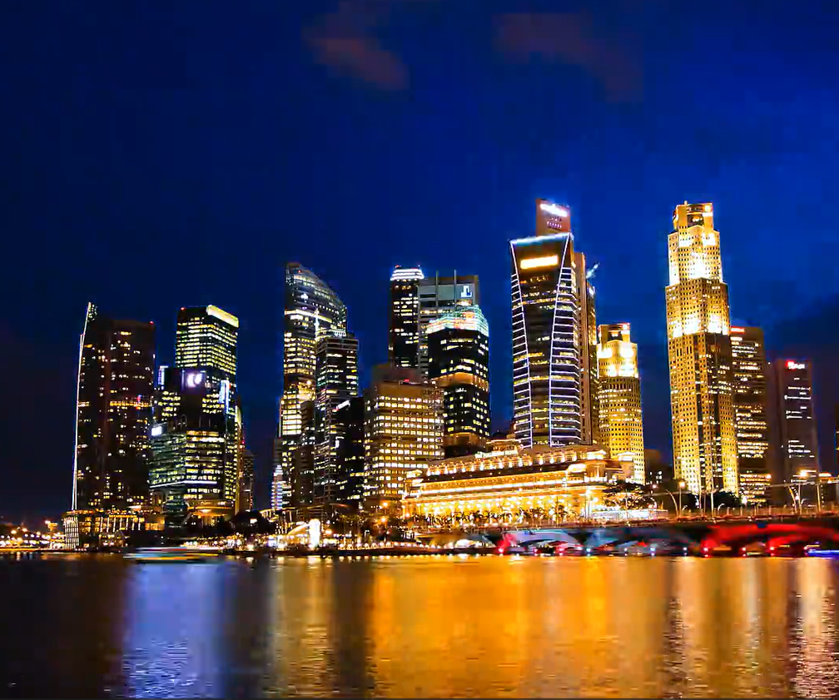
Dataset
2. TLVDB (Time-Lapse Video Database)
1. AMOS (Archive of Many Outdoor Scenes)
Image from webcam, has a timestamp lable
Real time-lapse videos, do not have timestamp for each frams

Slide 6
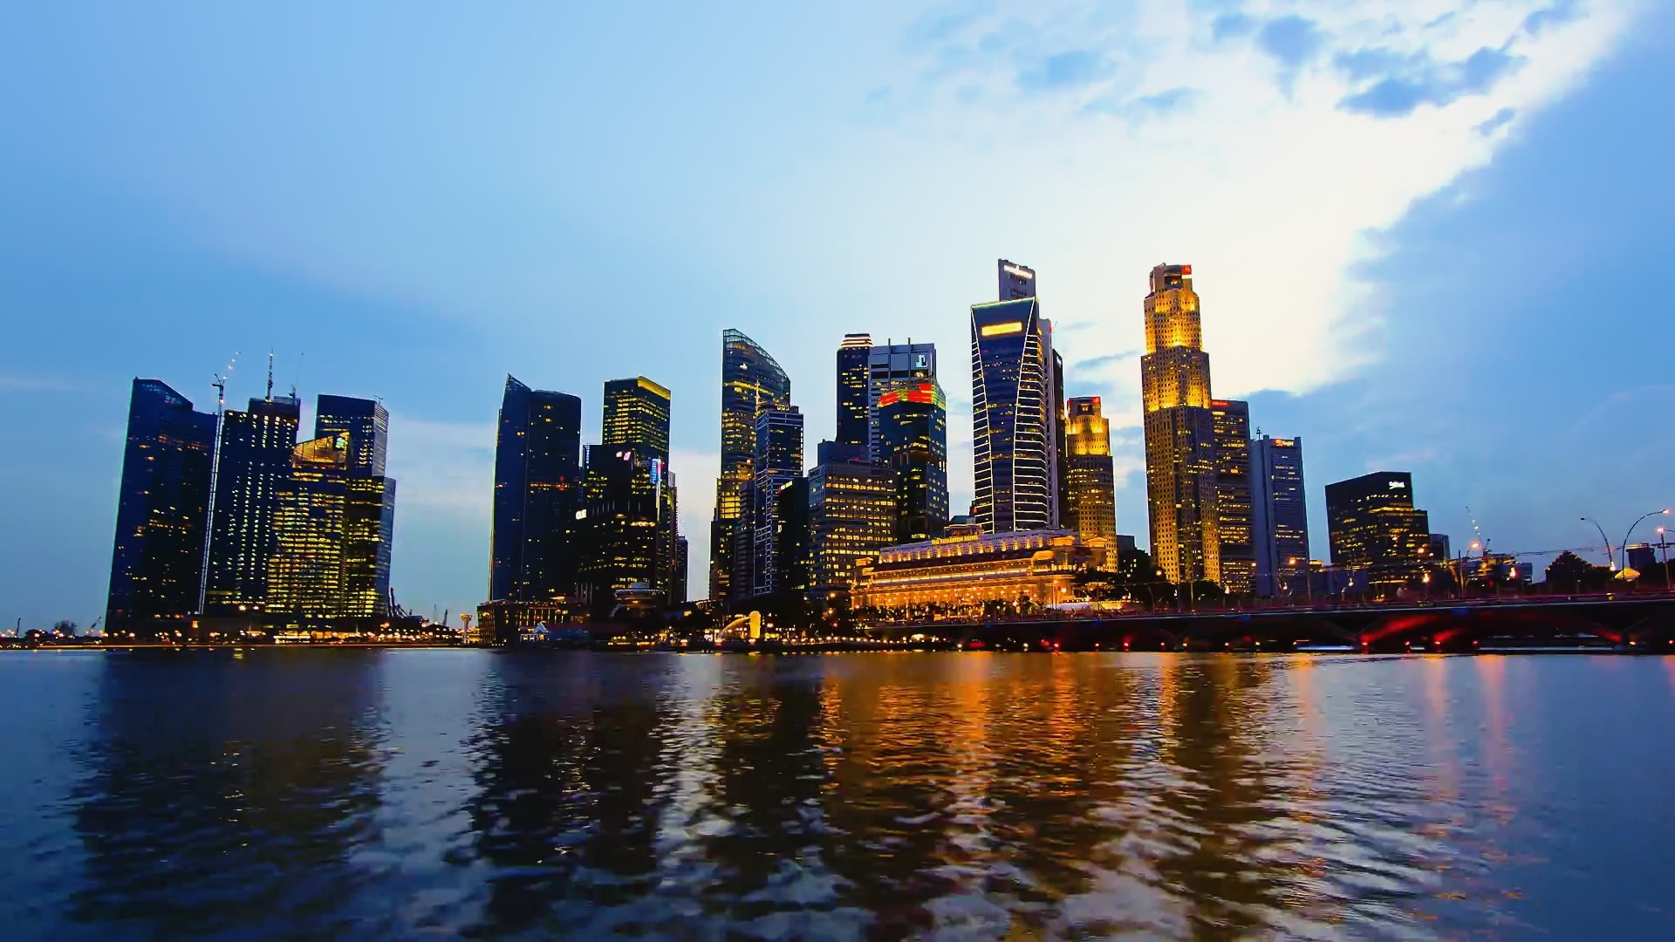
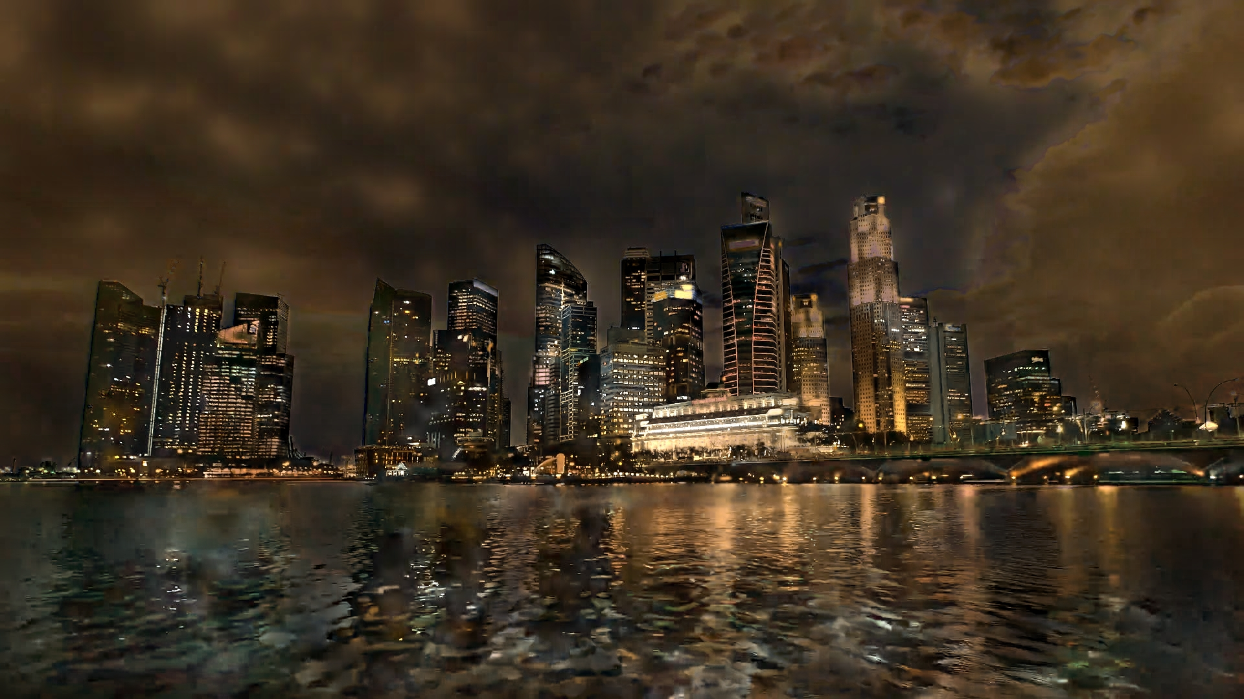
Method Overview
Conditional Image-to-Image Translation
Ît = G(I, t)
I: input image | t: timestamp | Ît: output at time t

Slide 7
Method Overview
Ĩ₀
Ĩ₁
I
G(I, t)
Aggregate
Ĩ₀
Ĩ₁
Ĩ_{n}
Video time-lapse
Ĩ_{n}

Slide 8
Multi-Frame Joint Conditional Generation
Generator Architecture
Discriminator Design
Encoder-Decoder with Shared Latent z
Two-Part Architecture
Encodes input image I
Uses shared latent variable z ~ N(0,1)
Residual blocks process features with timestamp t
Decoder generates output Î
D: Unconditional - checks if each frame is real
D: Conditional - validates temporal consistency
Max-pooling aggregation for permutation invariance
Key insight: Shared latent z captures temporal context across different times of day

Slide 9
Multi-Domain Training
Two Datasets with Different Characteristics
AMOS Dataset (A): 85.1K images with timestamps
Surveillance cameras, less interesting visuals
TLVDB Dataset (B): 135K images, no timestamps
Professional videos, rich illumination changes
Semi-Supervised Training
Use GA to translate TLVDB to AMOS domain, enabling conditional training without timestamps

Slide 10
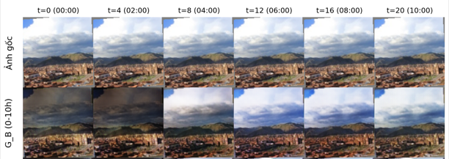
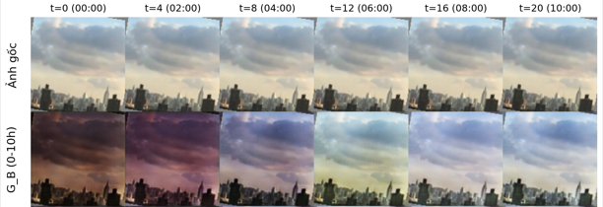
Result
Some output images during training

Slide 11
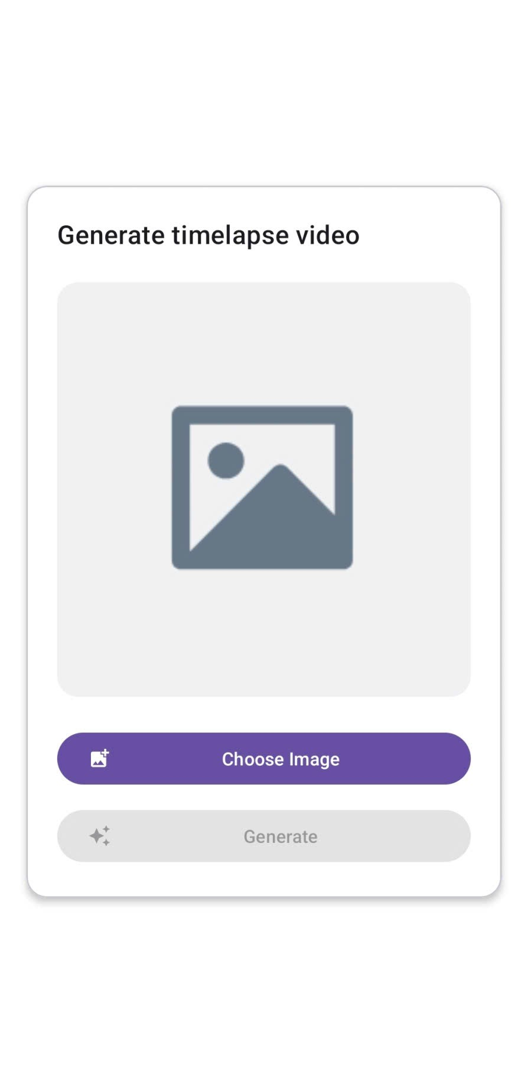
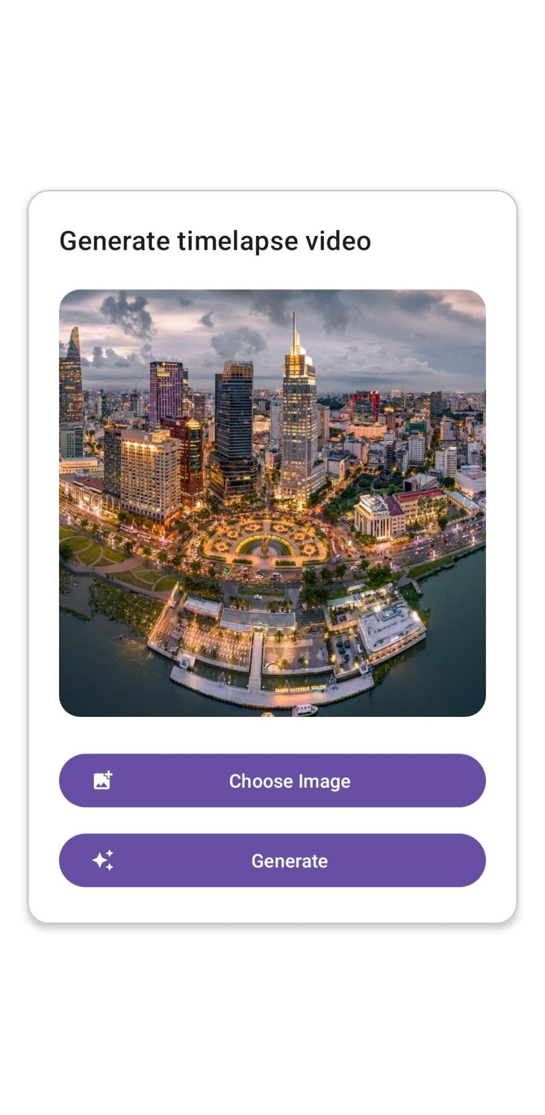
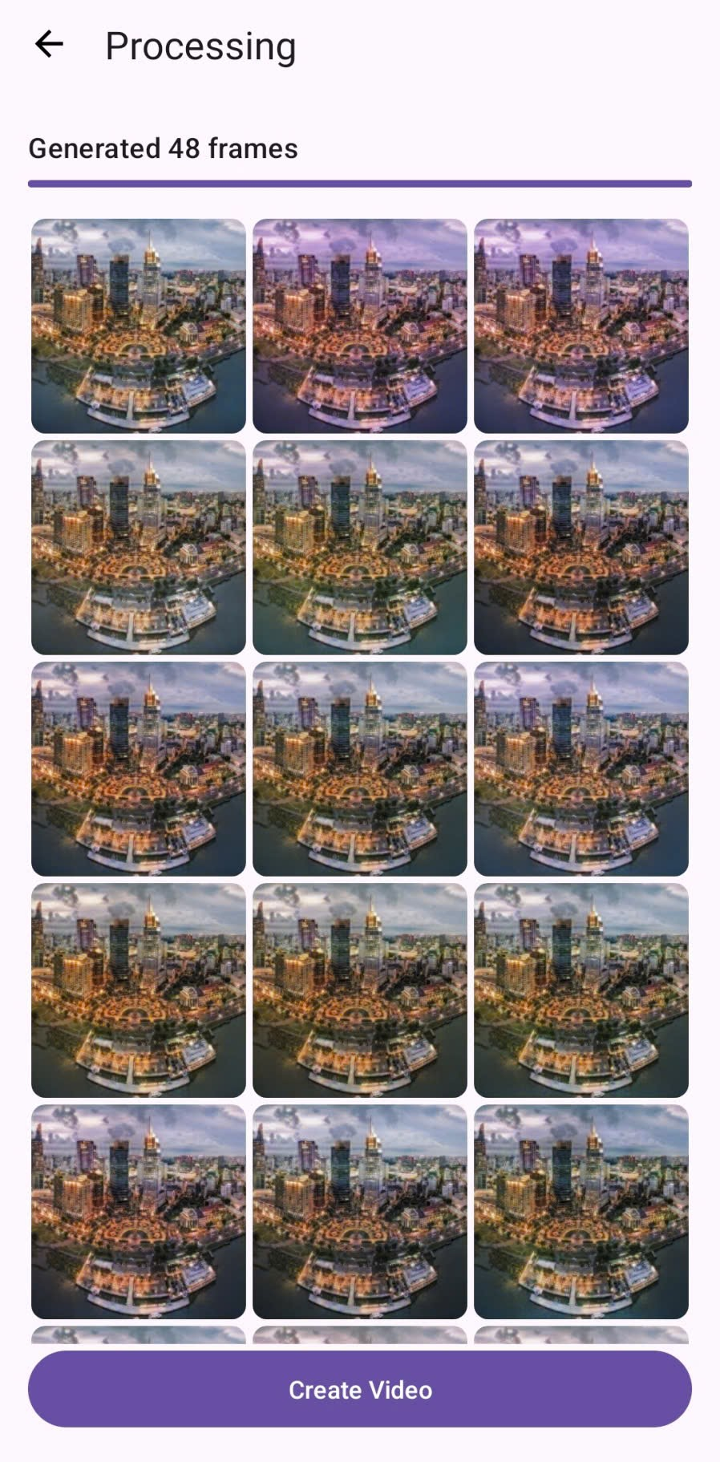
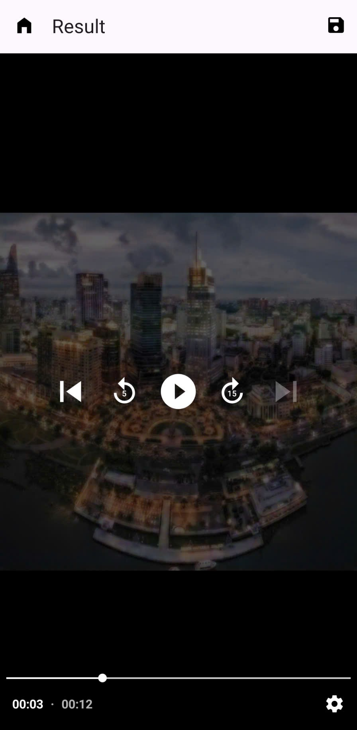
Android integration
Integrate into Android app using TorchScript and Pytorch Android

Slide 12
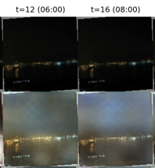
Conclusions
Limitations:
Struggles to hallucinate daytime image from very dark nighttime inputs
Fails to generate artificial lighting in regions like building windows
It only changes color tones and image quality is not really good
Runtime on android is not good, not really optimized

Slide 13
Conclusions
Future works
Improve the current approach: train on bigger and better dataset, better model architecture
Combine the current approach with motion synthesis techniques.
Improved to run better on mobile environment

Slide 14
Thank you for listening

